Slide 1

#TeamNannyState

Slide 2



Sentricare

Slide 3

Committed

Slide 4

Secure

Slide 5

Support

Slide 6
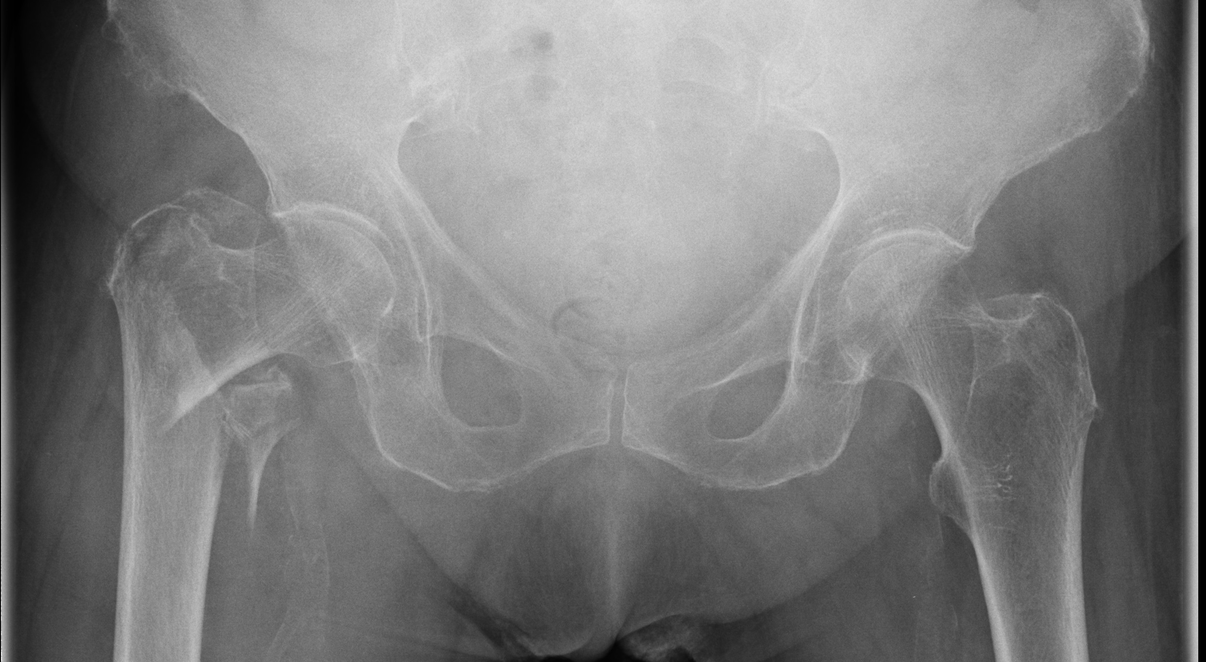
Prevent

Slide 7

Respond

Slide 8

Alert

Slide 9

With You

Slide 10





Insight

Slide 11

Always

Slide 12

Safe.

Slide 13
#TeamNannyState

